Slide 1


Mr. MailXpert - A Smart Fake Job Email Detection App
Applying Design Thinking to Identify Scam Job Emails
by JEEVAN .S

Slide 2
The Growing Threat of Job Scam Emails
Fake job emails are rising rapidly, targeting vulnerable job seekers.
Many victims suffer financial losses and reputational damage due to these scams.

Slide 3
Design Thinking: Our Innovative Approach
1
Empathize
2
Define
3
Ideate
Understanding the needs and challenges of job seekers.
Clarifying the problem and setting specific goals.
Generating creative solutions and exploring possibilities.
4
Prototype
5
Test
Building a working model to test and refine the app.
Gathering feedback from users and iterating based on their insights.

Slide 4
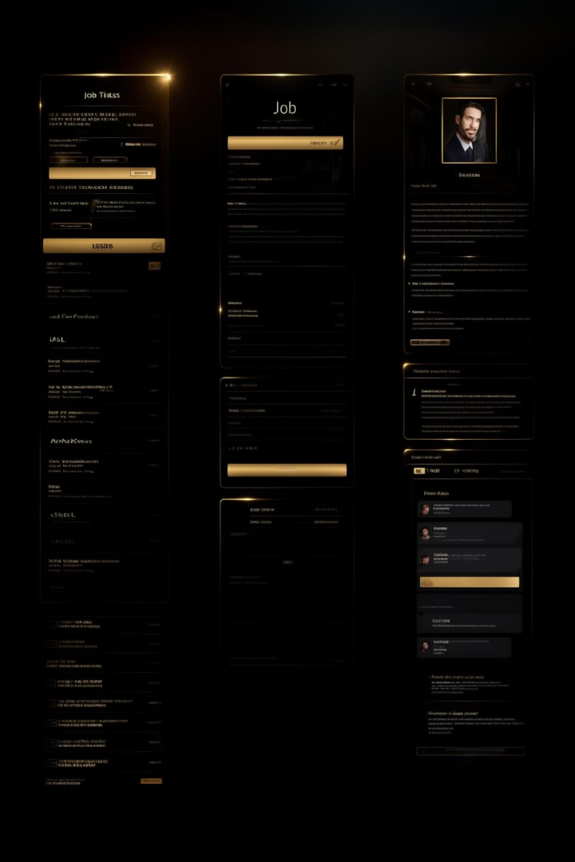
Understanding User Pain Points in Job Hunting
Unreliable Email Sources
Lack of Verification Tools
Job seekers struggle to distinguish legitimate emails from scams.
They lack effective tools to verify job offers and company authenticity.
Time-Consuming Research
Manually verifying information can be tedious and time-consuming.

Slide 5




Empathy Mapping: Connecting with Job Seekers
Feeling overwhelmed by the sheer volume of emails.
Questioning the legitimacy of job offers.
Hoping for a quick and easy way to find a job.

Slide 6
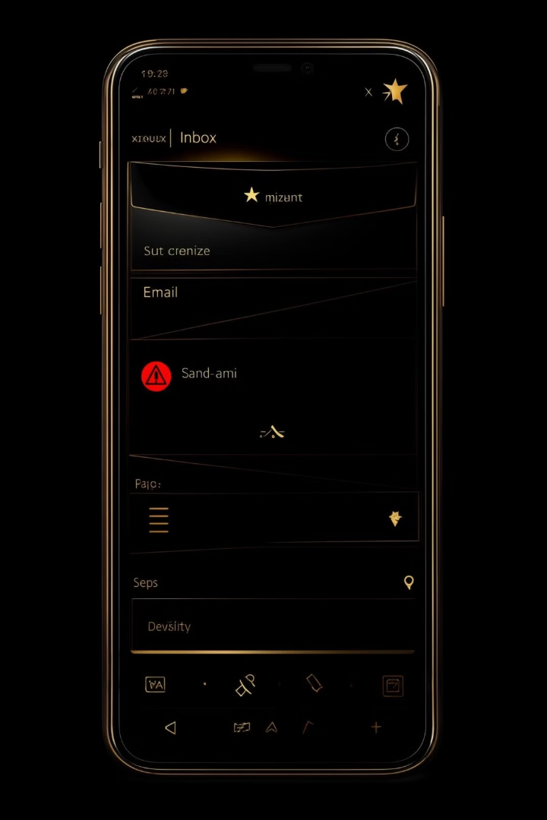
Prototype Development: AI-Powered Email Analysis
1
Leveraging machine learning to analyze email content, sender information, and links.
2
Identifying common red flags and suspicious patterns in scam emails.
3
Providing real-time feedback to users with alerts and recommendations.

Slide 7




User Testing and Validation Process
Conducting user testing sessions with a diverse range of participants.
Collecting valuable feedback on the app's usability, effectiveness, and user experience.
Analyzing results and iterating on the app design and features.

Slide 8

Key Features of Mr. MailXpert
User profile to personalize job search preferences and save relevant information.
Real-time alerts and notifications to warn about potential scams.
Company verification tool to confirm legitimacy and authenticity.
Email scanner to detect suspicious content and links.

Slide 9
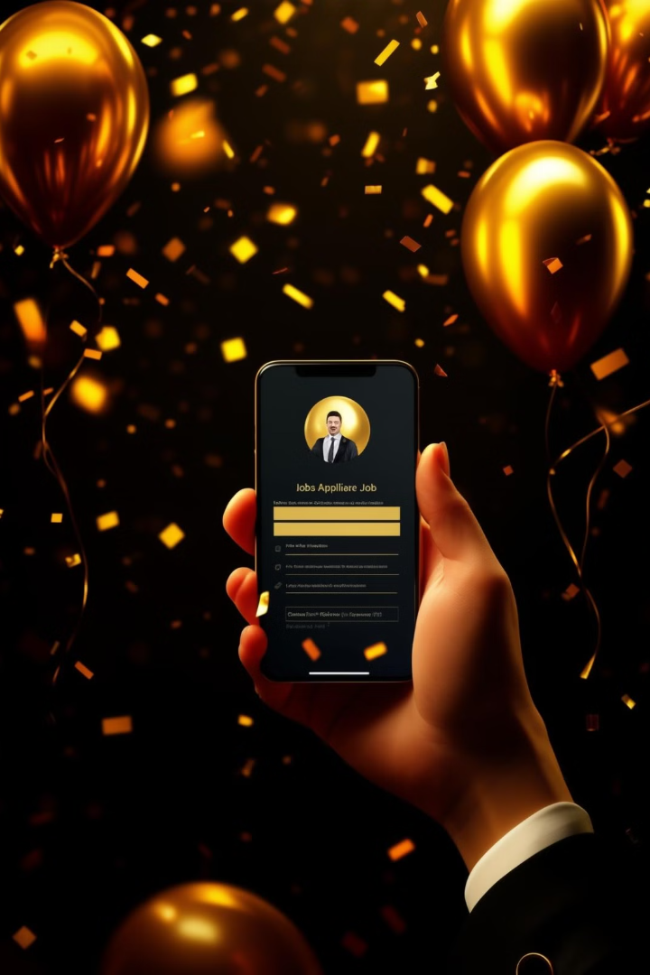
Real-World Impact and Success Stories
1000
Downloads
Mr. MailXpert has been downloaded by thousands of job seekers.
90
Success Rate
The app has a high success rate in identifying fake emails.

Slide 10

Future of Cybersecurity in Job Recruitment
Mr. MailXpert is paving the way for a safer and more secure job search experience.

